Slide 1
Happiness & Sentiments Project 3 – Team 3
Team:
Shreenidhi Thotadamoole
Sowmya Kotipalli
Marco Nigro
Ryan Sambila

Slide 2
Agenda
Introduction: What questions are we trying to answer
Data Ethics: Data Classification
Data: How data is obtained, cleaned and stored
Happiness Score
Happiness vs. Social Media Sentiments
Happiness Interactive Visualizations
Demo
Summary

Slide 3
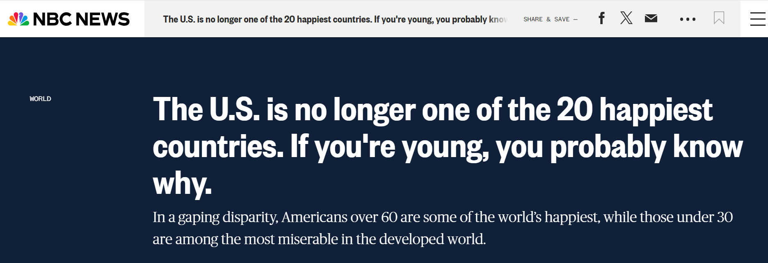
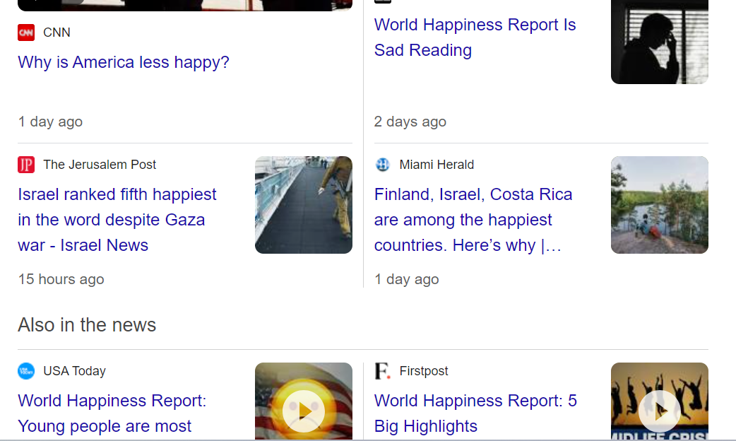
Introduction

Slide 4
Are we more happier if we are richer !!!
01
Which Country is happiest in the world and why?
02
How do Countries GDP, Corruption, Social support impact its “Happiness Index”?
03
Are these factors reflected in Social Media? How does Social media sentiment relate to Happiness Index?

Slide 5
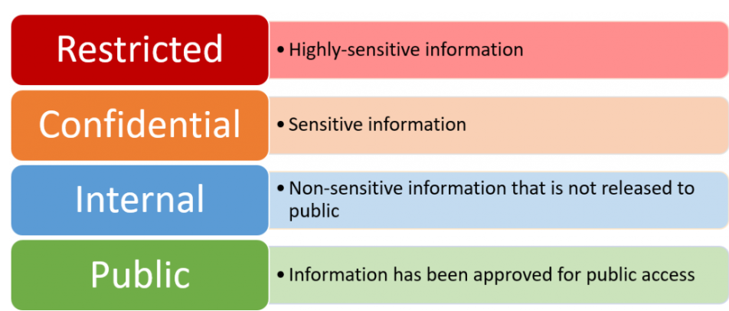
Data Ethics: Data Classification

Slide 6
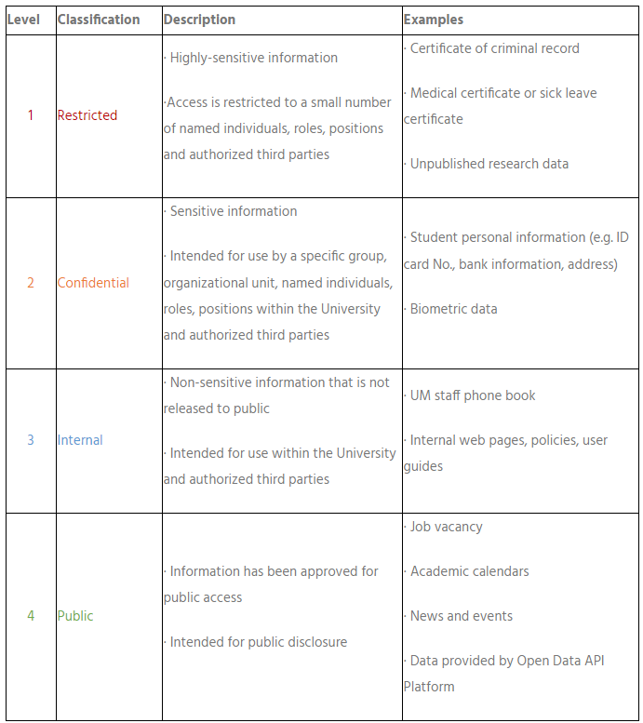
Data Ethics: Data Classification Examples

Slide 7
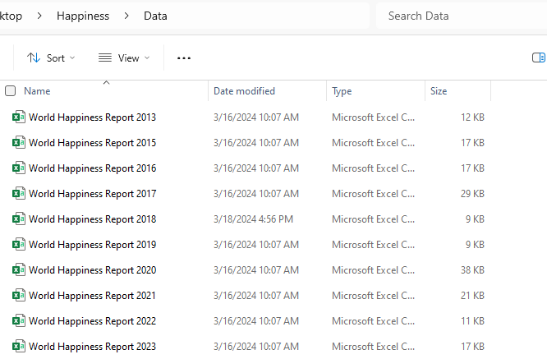
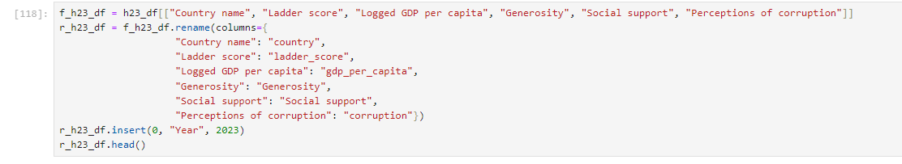
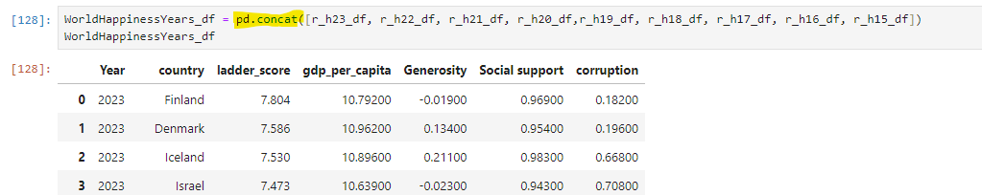
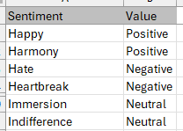
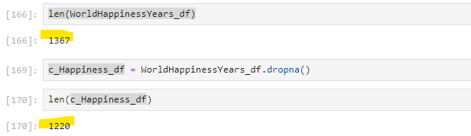
Build out Data
Multiple csv files with different header names for the same columns and only a few files had the exact same fields.
In Python Pandas we reordered and created a DataFrame for the new ordered columns.
Renamed the headers to all match
Inserted a year column
Unionized all new DataFrames
Cleaned the DataFrame for any rows with zeros or N/A from the csv file.
Sentiments files:
Imported & cleaned
Created x-ref table for: Sentiments => (Pos/Neg/Neut)

Slide 8
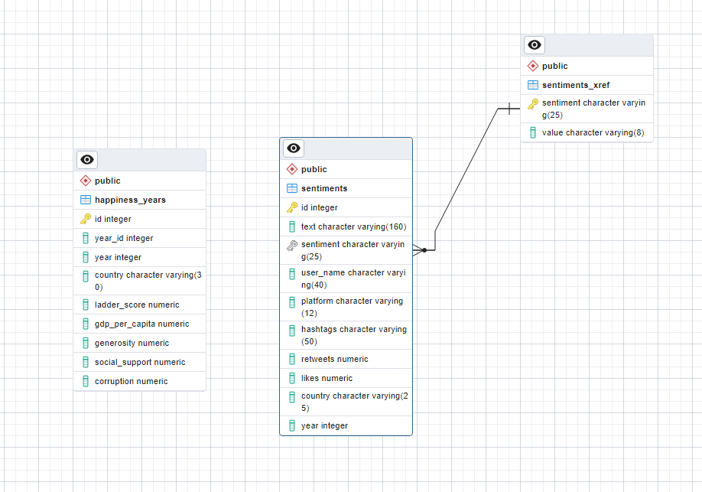
Storage of Data
Used pgAdmin to Create a SQL Database
Created Tables for
Happiness years Union
Sentiments
Pos/Neg/Neut xref
Joined Sentiments on xref table

Slide 9
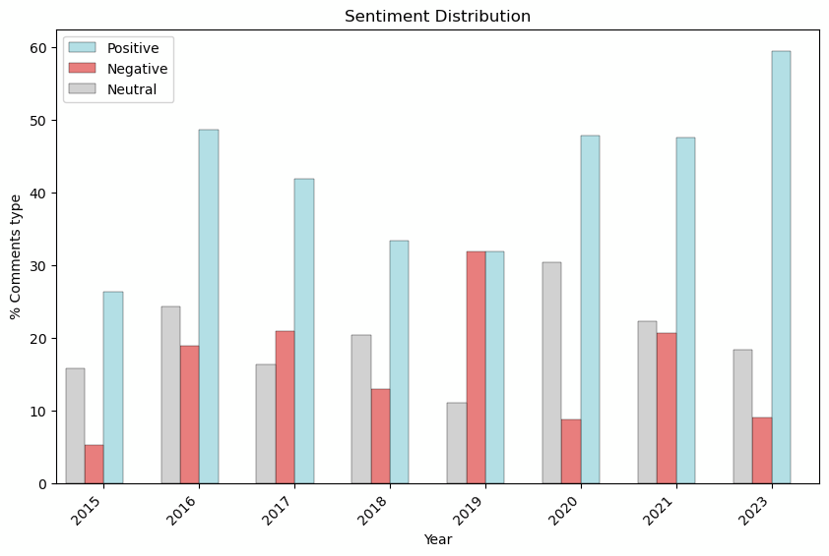


Exploring Emotion Distribution Across Social Media Platforms

Slide 10
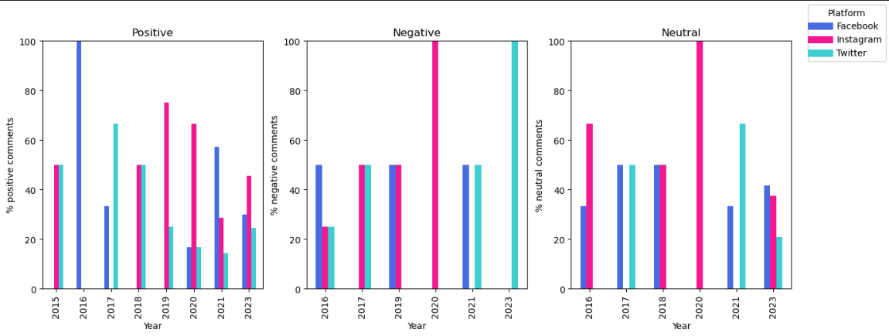
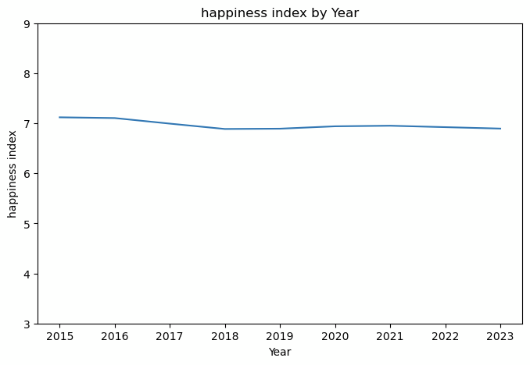
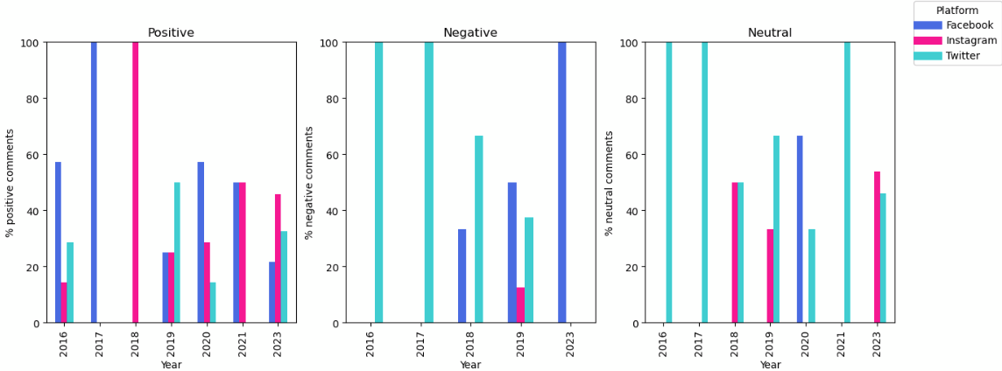
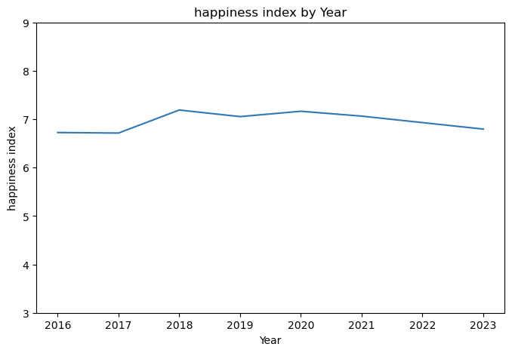
Analysis of Social Media Content Across Different Countries
USA
UK

Slide 11
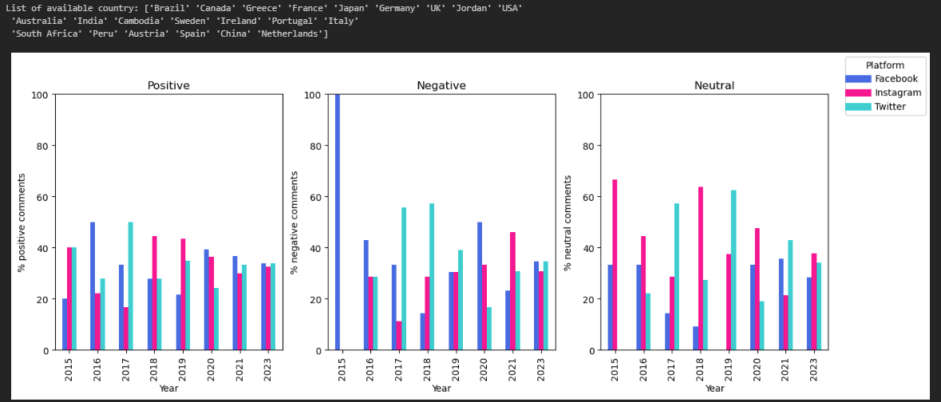
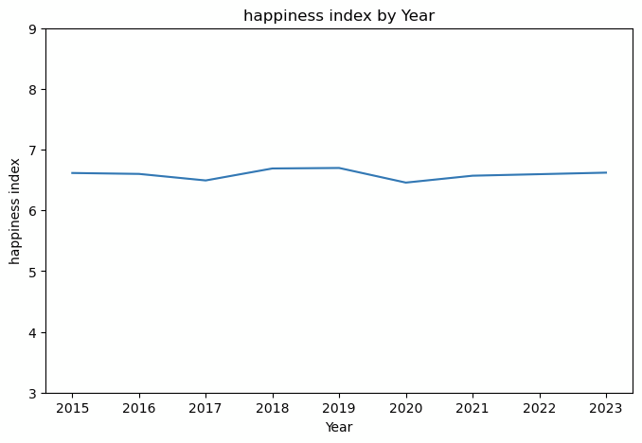
Analysis of Social Media Content Across All Countries

Slide 12
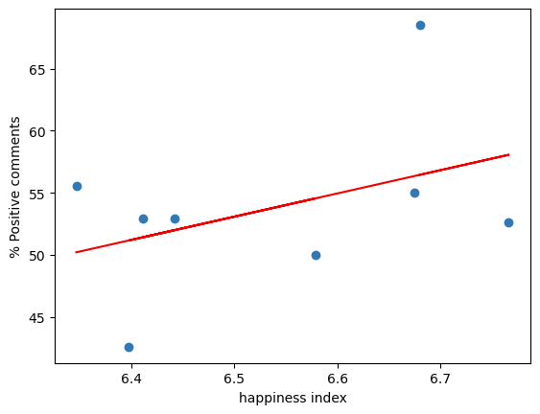
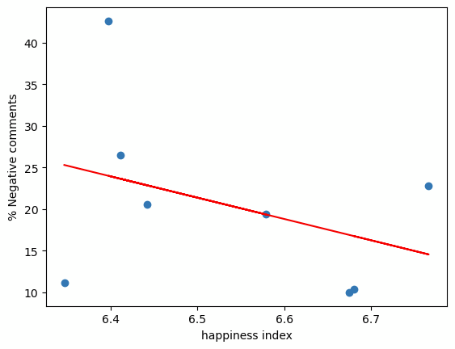
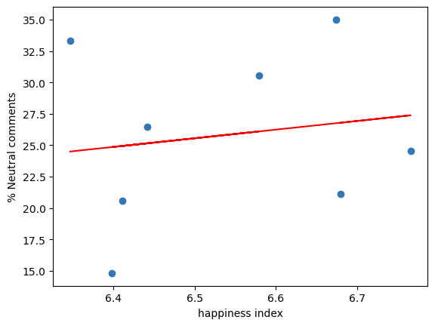
Happiness vs. Social Media Sentiments
The correlation between happiness index and the positive comments is 0.41
The correlation between happiness index and the negative comments is -0.37
The correlation between happiness index and the neutral comments is 0.16

Slide 13
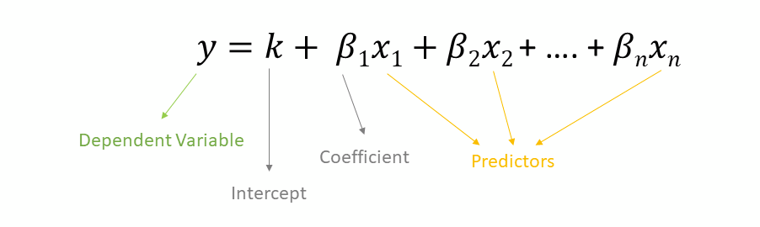
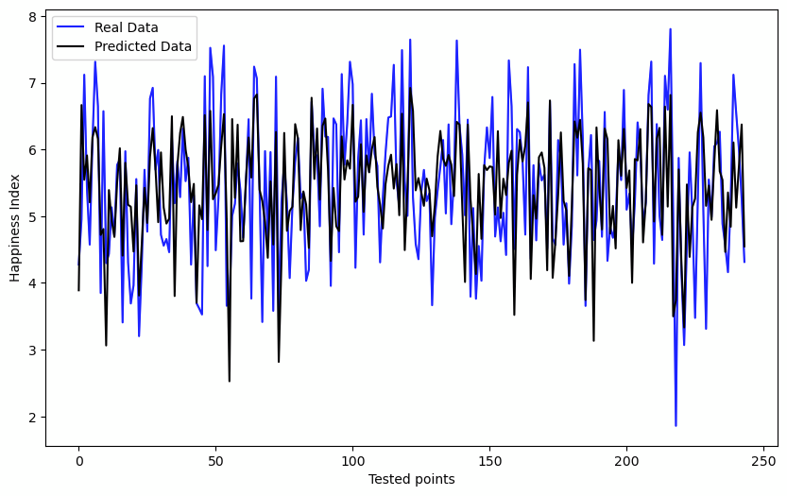
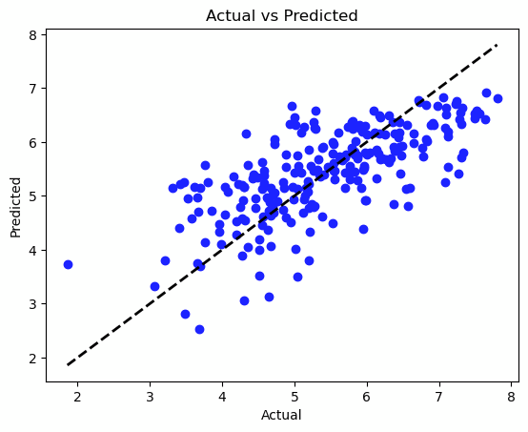
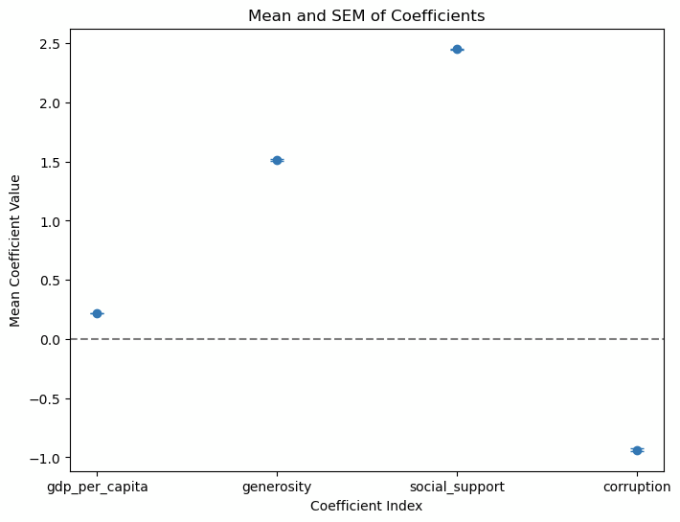
Impact of Various Factors on the Happiness Index: General Linear Model
'gdp_per_capita',
'generosity',
'Social_support',
'corruption'
R-squared: 0.50
****
****
****

Slide 14
Happiness Interactive Visualizations
Demo - switch to the interactive page

Slide 15
Summary & Takeaways
01
Which Country is happier in the world and why?
02
How does Countries GDP, Corruption, Social support impact its “Happiness Index”?
03
Are these factors reflected in Social Media? How does Social media sentiment relate to Happiness Index?

Slide 16
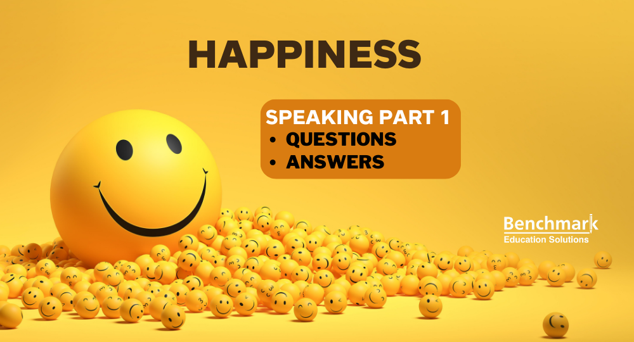
Questions?
Thank You!
☺

